Slide 1
Navigating Your First 5 Years in IT / InfoSec
Presented by:
Michael Rogers and Britanee TeBrake

Slide 2
Topics for Discussion
Competitive Mindset
Lifelong Learning
Secrets to Personal Branding Success
Pro Skills for Networking and Mentorship

Slide 3

Notes:
How do you stand out in a crowd of your peers? It takes an ongoing competitive mindset to do so.

Slide 4

Competitive Mindset
Notes:
There’s going to be a lot of great people surrounding you – as there are here today. The key to a competitive mindset is being confident in what sets you apart from your peers by….
get clear on your greatest strengths
own your weakness(es)
know your values (the things you demonstrate daily)

Slide 5
Competitive Mindset
purpose
consistency
resilience
Notes:
Be mindful of how you show up – from how you dress, to your communication style (eye contact), the confidence you exude
Take consistent action – what you do everyday is more important than what you do once in awhile.
It won’t always go the way you plan, stay focused
**2 most common faltered questions in an interview?
1. Tell me about yourself
2. Biggest opportunity/weakness

Slide 6

Competitive Mindset
Having little to no knowledge of the company is the most common mistake made during interviews (Undercover Recruiter)
Notes:
DO YOUR RESEARCH. You should be interviewing the company and your leaders, just as much as they are interviewing you.

Slide 7
Lifelong Learning
Notes:
Early Career
Say YES! Then ask for more.
Constant Refresh

Slide 8
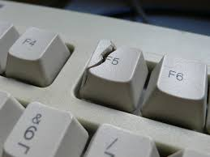
constant refresh

Slide 9
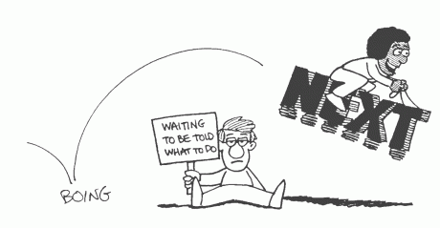
Lifelong Learning
Notes:
Volunteer – say yes!, take initiative and ask to do more
Excitement early on to take on the jobs that nobody else wants to do
Be hungry
Add tools and experiences to your toolkit
Being an expert today doesn’t mean you will be tomorrow

Slide 10
Personal Branding
Notes:
Six degrees
Who you are matters – Reputation
People buy from…

Slide 11
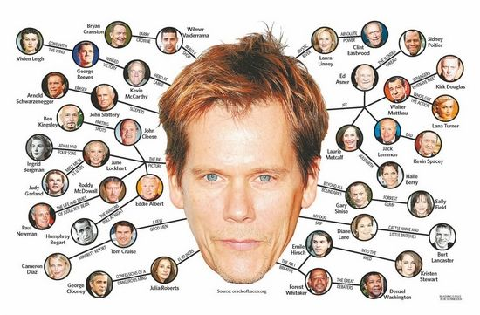
Notes:
Who knows who this is? What’s the concept?
But it’s not just about who you know, it’s what you do and how you connect with who you know.
Remember this slide --

Slide 12
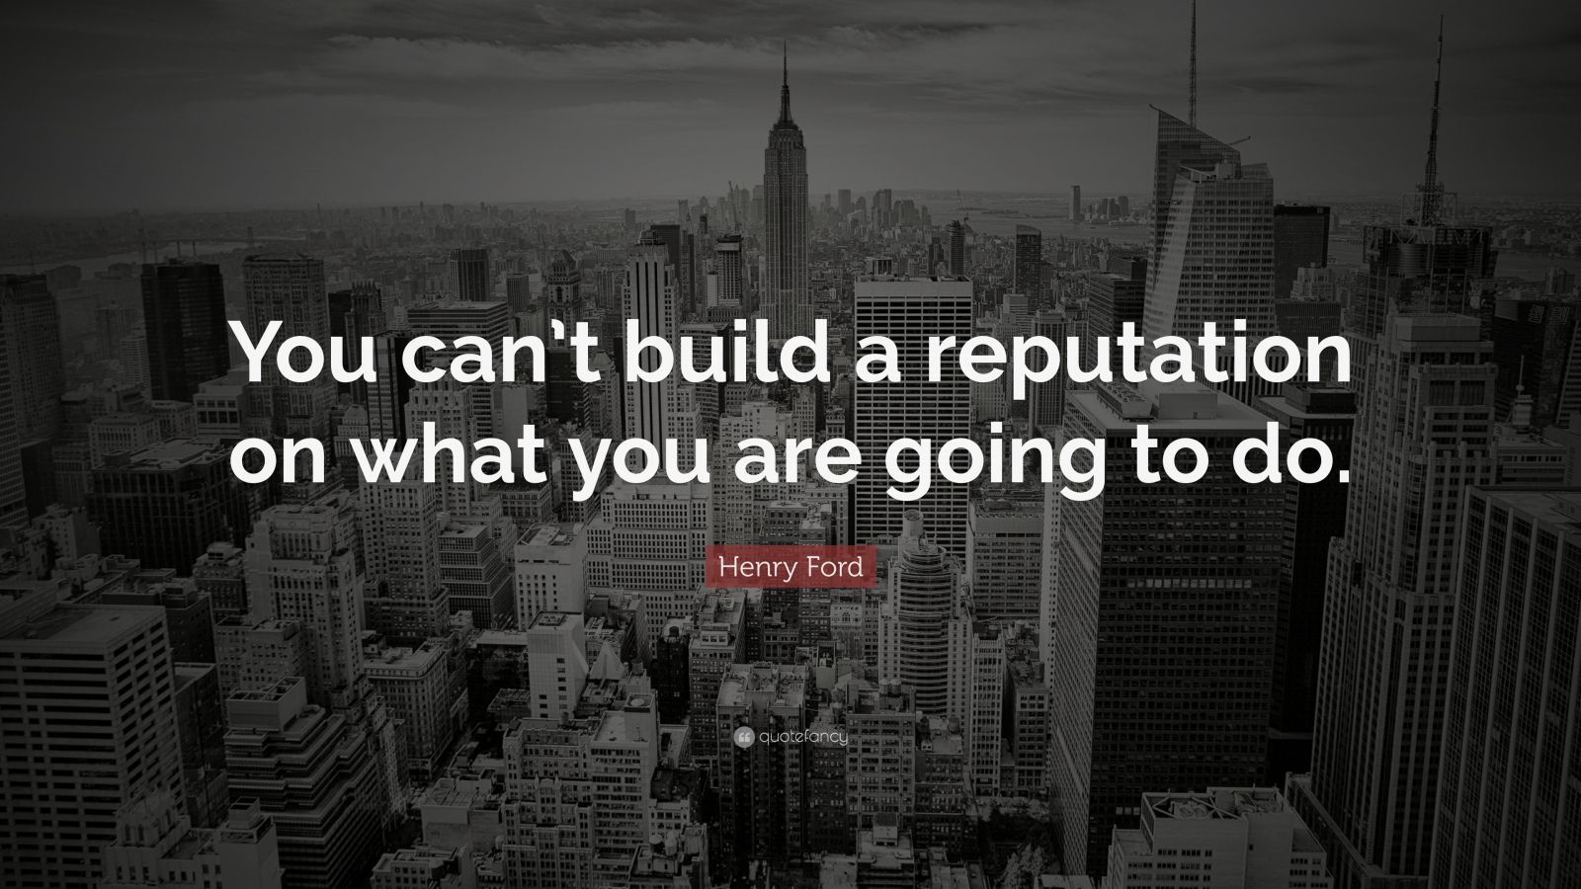
Notes:
Reputation is your track record. Be a person of character and ever-increasing capability.
Henry Ford said, “You can’t build a reputation on what you are going to do,” so reputation only comes after you make the investment.
As your career lengthens, you run into more and more of the same people. The way you treat people now will impact your career down the road (for good or bad).
Why else is this important?...

Slide 13
Personal Branding
People do business with people they…
KNOW, LIKE and TRUST.

Slide 14
Personal Branding
hire
People do business with people they…
KNOW, LIKE and TRUST.

Slide 15
Networking and Mentorship
Notes:
Mentors
Not static
Support Team
Networking
Formal events
Go do stuff you like
Most jobs are never posted

Slide 16

Mentors
Notes:
Show of hands, how many people have a mentor? What role do they play for you? Why did you choose this person?
Consider this…

Slide 17
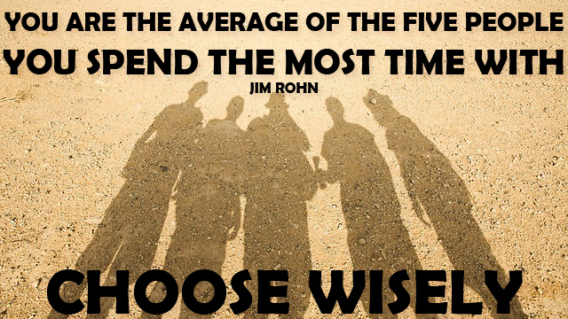
Notes:
If there’s time we can walk through the worksheet or I can just briefly hit the important parts of the exercise.

Slide 18
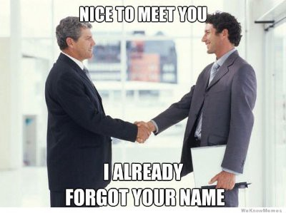
Networking
Notes:
Choose non-lame events (alumni groups) or host your own
Bring a wingman or woman
Set a goal i.e. make 10 new connections
Ice breaker go-tos:
“I can’t stop eating these kabobs. Have you tried them?”
“What a beautiful venue. Have you been here before?”
“I’ll be honest, the only person I know here is the bartender, and I just met him two minutes ago. Mind if I introduce myself?”

Slide 19


